Slide 1
Shareholding Data Analysis

Slide 2
Objective
Analyze Shareholding data to rank manager’s performance
Identify Signals for Long only equity strategy
What could have been done better – given time and data?

Slide 3
Action Plan
Load the data and look for any data inconsistency and outliers
Combine Shareholder data with Transaction Data
Leverage Security Pricing and Benchmark (MSCI) data to calculate beta for each of the security
Combine Shareholding data to Security pricing and calculate Value invested, Portfolio weights, Security Returns, Weighted Returns, and Weighted Beta across quarters
Summarize Portfolio Stats such as Absolute Returns, Risk Adjusted Returns, Rolling Returns, Avg. Beta, Plugin Alpha, and Benchmark Excess Return
Rank Managers based on Absolute Return and Risk Adjusted Returns (Information ratio or Active Returns)
Find patterns based on rolling returns, Portfolio returns, Avg. Beta, plugin Alpha, and Benchmark excess returns
Given time and data– what could have been done better

Slide 4
Combining Holding and Transaction Data
I have made few assumptions – while updating Shareholding data with Transaction data.
Transaction filing could be on any business day in the month while holding data is only at the quarter end. Hence, I have projected filing date to the end of quarter. I have considered following cases:
If it is a Buy and a position exists – assuming held quantity is included in Shareholder return numbers – I have updated Market value as Shareholders MV – Reported Number Value at QE + Reported Number Value at Filing day
If it is a sell and a position exists, I have assumed that holding numbers are correctly being reported. (in lack of sanity check for the last quarter numbers + buy/sell = current quarter numbers)

Slide 5
Combining Holding and Transaction Data…. Continued
If it is a Buy and no position exists – fetch previous quarter position –
a) if it does not exist – simply establish the position with
transaction details with outstanding shares.
b) If it exists, update quantity, value, and outstanding shares
If it is a sell and no position exists – fetch previous quarter position –
a) if it does not exist – assume that manager got out of the position and do nothing
b) If it exists, update (reduce) quantity, value, and outstanding shares
c) If quantity goes negative but positive value held – establish the position
d) However, in case of negative value held, do nothing
There are 70 positions that get updated with above rule. There are 4 positions that have positive value held but quantity held is zero. I have kept it in analysis preview.

Slide 6
Calculations
I have made below calculations for the required analysis
Market Value Held (Security) = Total Shared held * Quarter Close price
Total Market Value Held = sum(Market Value held)
Total o/s updates (transaction updates) : total shares = (1/percentage outstanding shares) * shares held;
New O/s shares = new position / total shares
Security Price Return (Quarterly) : (Current-Previous)/Previous
Portfolio return (Quarterly) : (Current-Previous)/Previous
Portfolio Weight : Value held for position / Total Value held by Manager
Weighted Security Return = Portfolio Weights * Sec Price Return (w1r1)

Slide 7
Calculations……Continued
Security Beta = Covariance (Stock, Market) / Variance of Market
Weighted Portfolio Return = sum(Weighted Security Return)
Weighted Security Beta: Portfolio Weight * Beta
Avg Beta = mean(Weighted Security Beta)
Total Portfolio Return (Time Weighted return) : (1+r1)…(1+rn) -1
Market Return = (Time Weighted return) : (1+r1)…(1+rn) -1
Benchmark Excess Return = Total Portfolio Return – Market Return
Plugin Alpha = Avg Beta * Market Return – Total Portfolio Return
Rolling Return = Last six months Portfolio returns
Variance = Variance of Excess Returns
Std. Deviation = Square root of Variance
Rank : Based on max value (higher the better)
Information Ratio or Active Return = Portfolio Return – Benchmark Return / Std. Dev of Excess Return

Slide 8
Part 1 – Manager’s Ranking
Based on the absolute return, Steadview is ranked on the top
Based on the risk adjusted return ratio (active return or Information ratio), Steadview is still ranked on the top
Risk adjusted return ratio is calculated as (Portfolio Return – Benchmark Return) / Std. deviation of Excess return

Slide 9
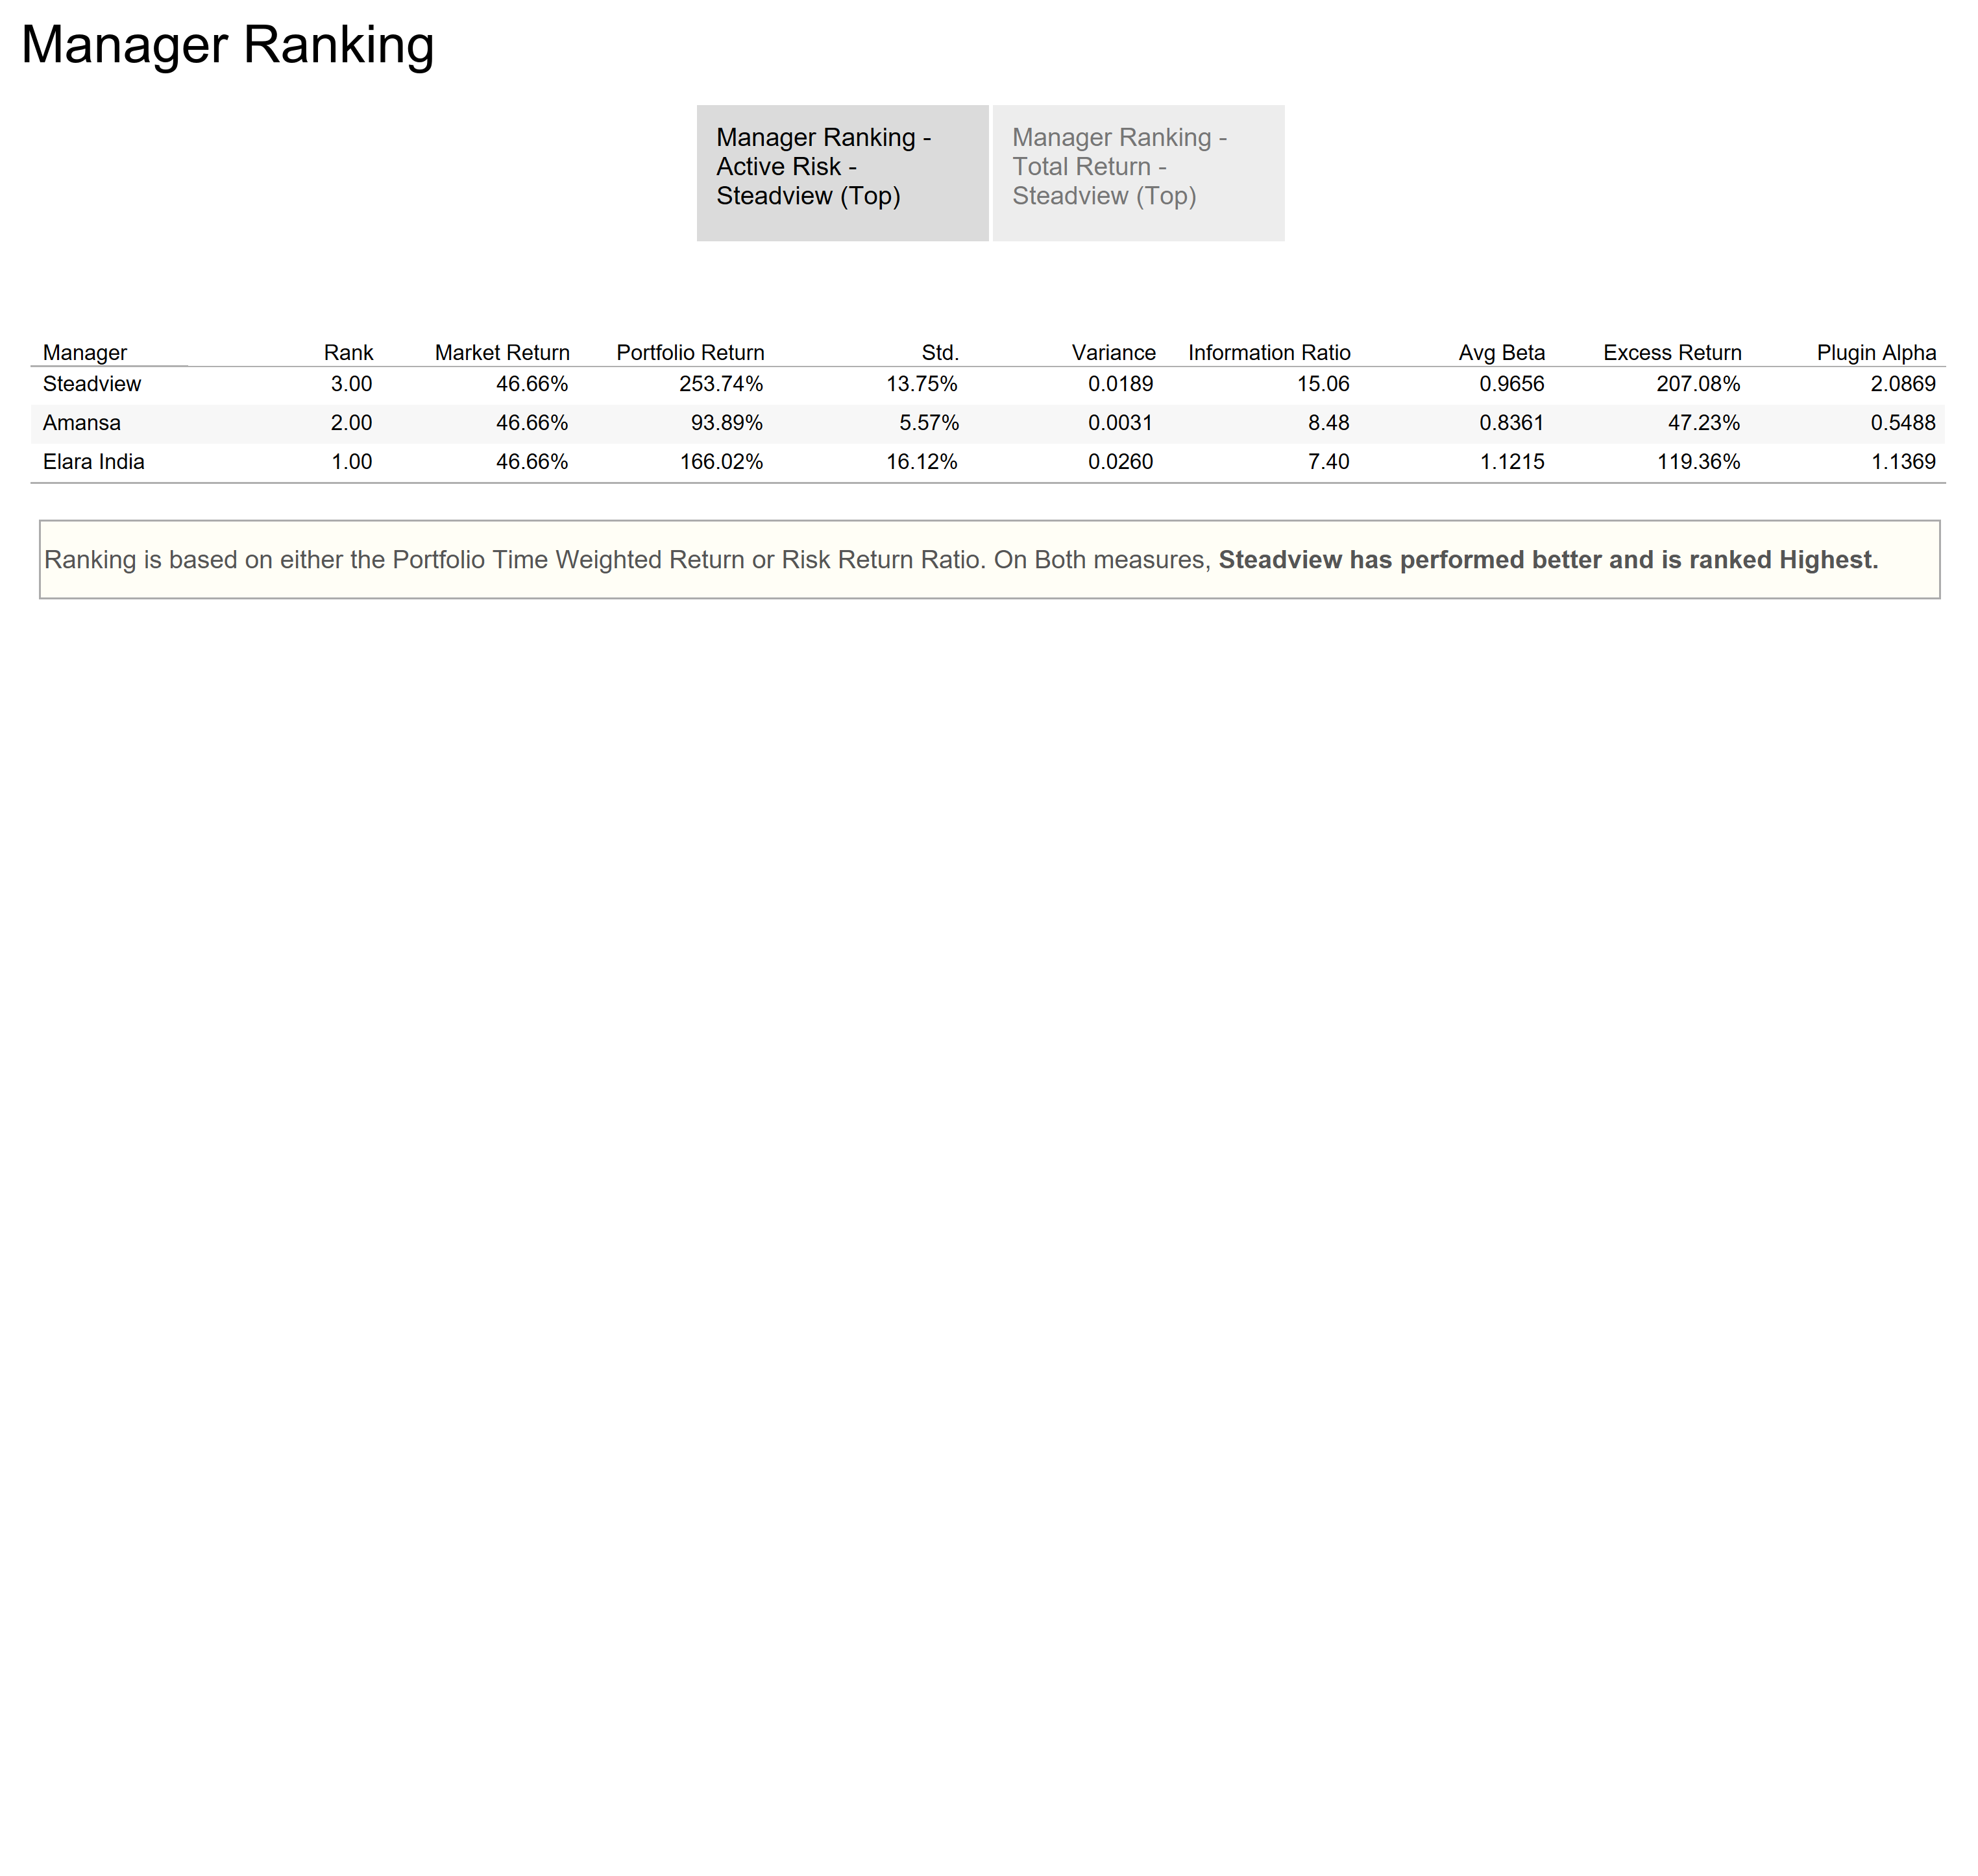

Slide 10
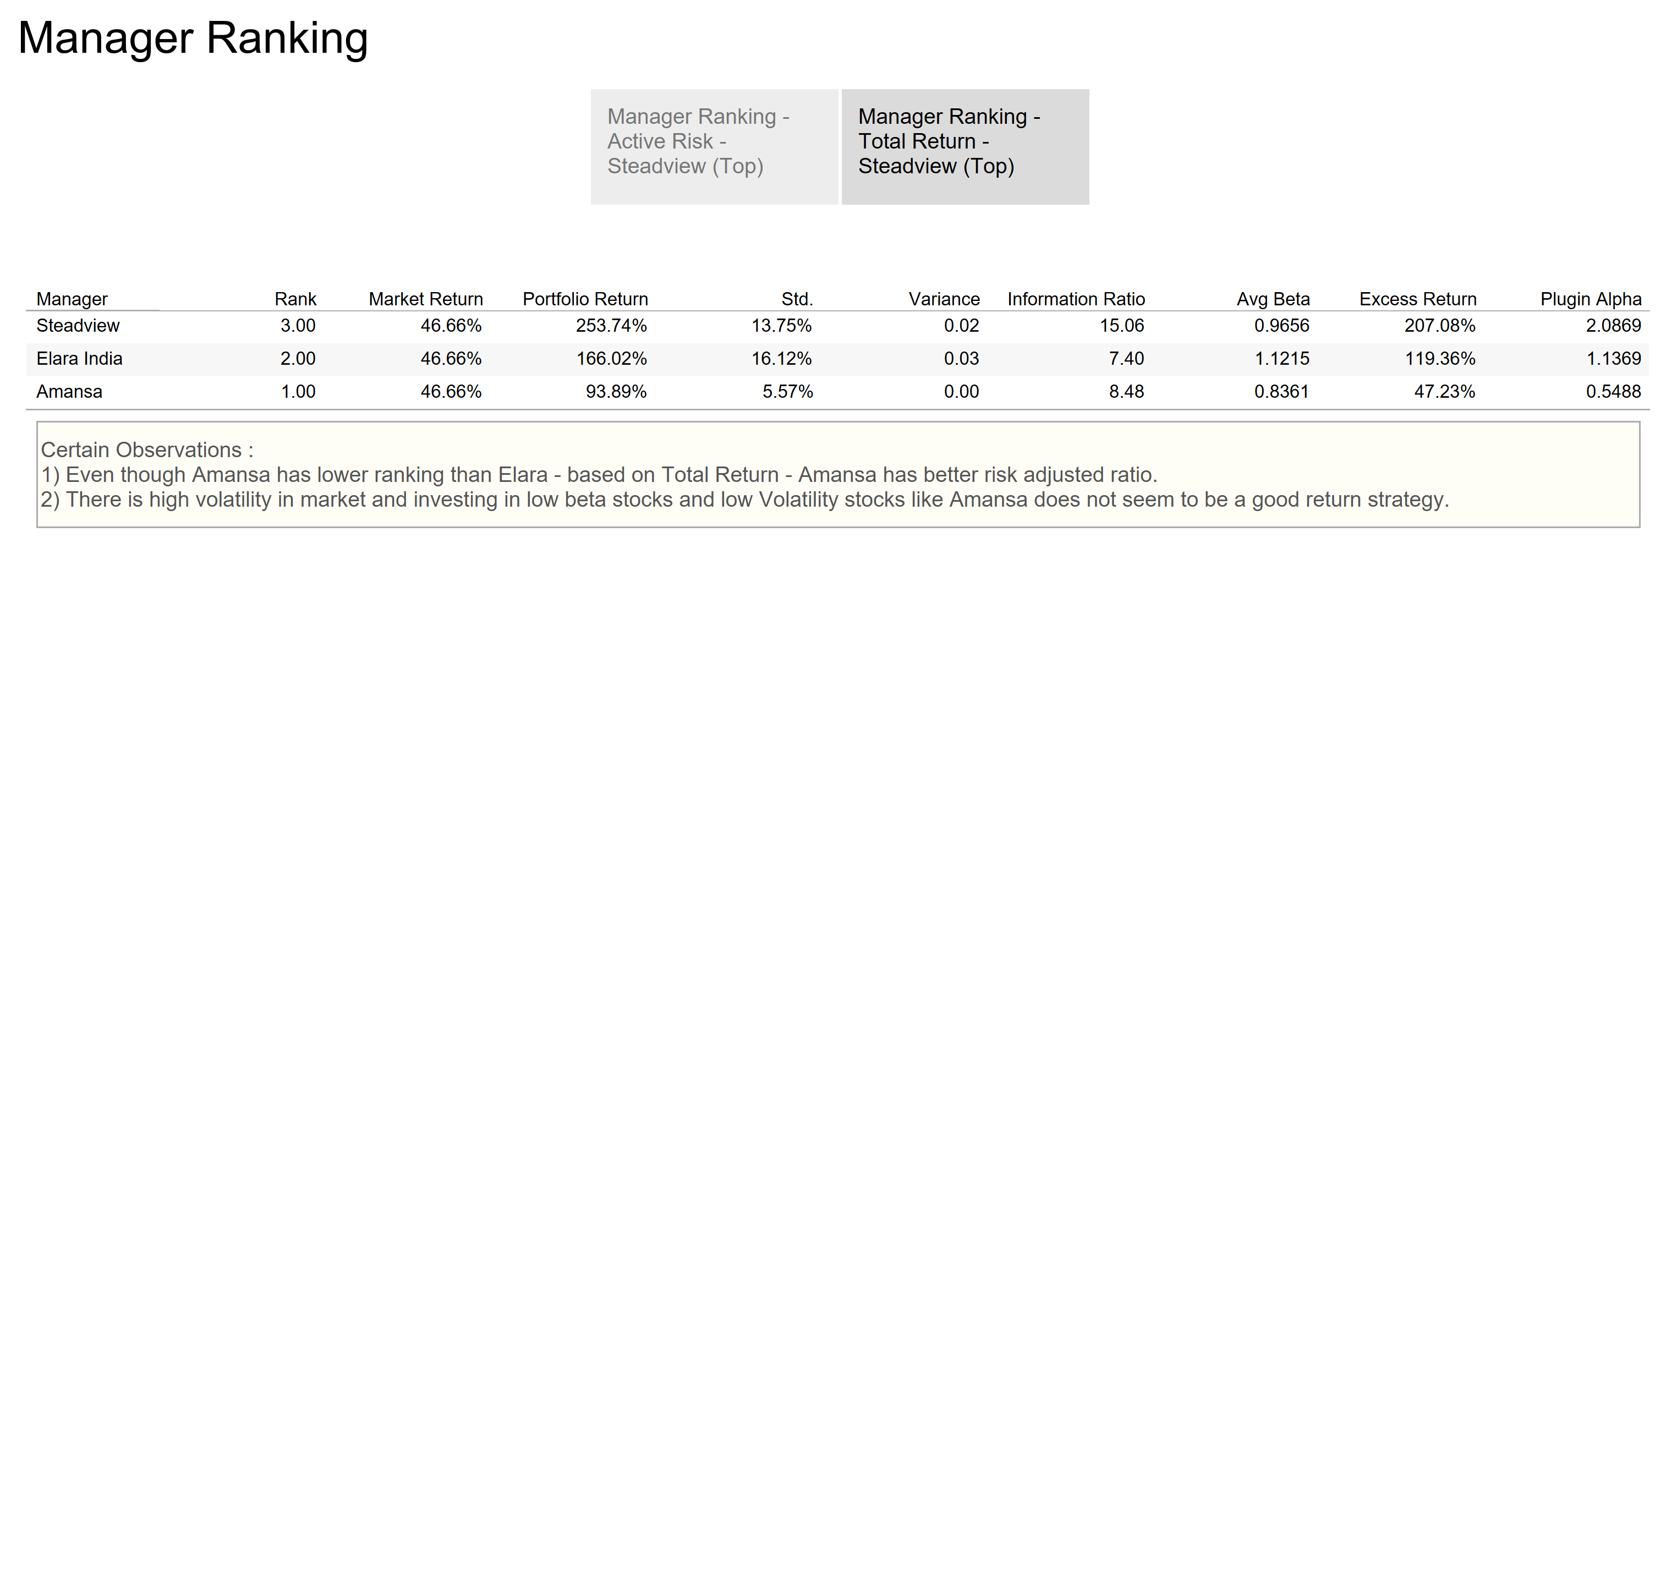

Slide 11
Part 2 – Trading Signals
Based on rolling six months returns and plug-in alpha, Long term signal is to avoid high beta stocks and stay invested with high alpha stocks
Benchmark excess returns trend further confirms this trend
I have highlighted one of the cases - finding significant drop in Elara Portfolio return for 2018Q2
Timeseries prediction on Portfolio returns are not correct. There is a trend in Elara returns, periods are too less to have a viable time series forecasting, and there are various other factors that need to be considered for Predictive modeling

Slide 12
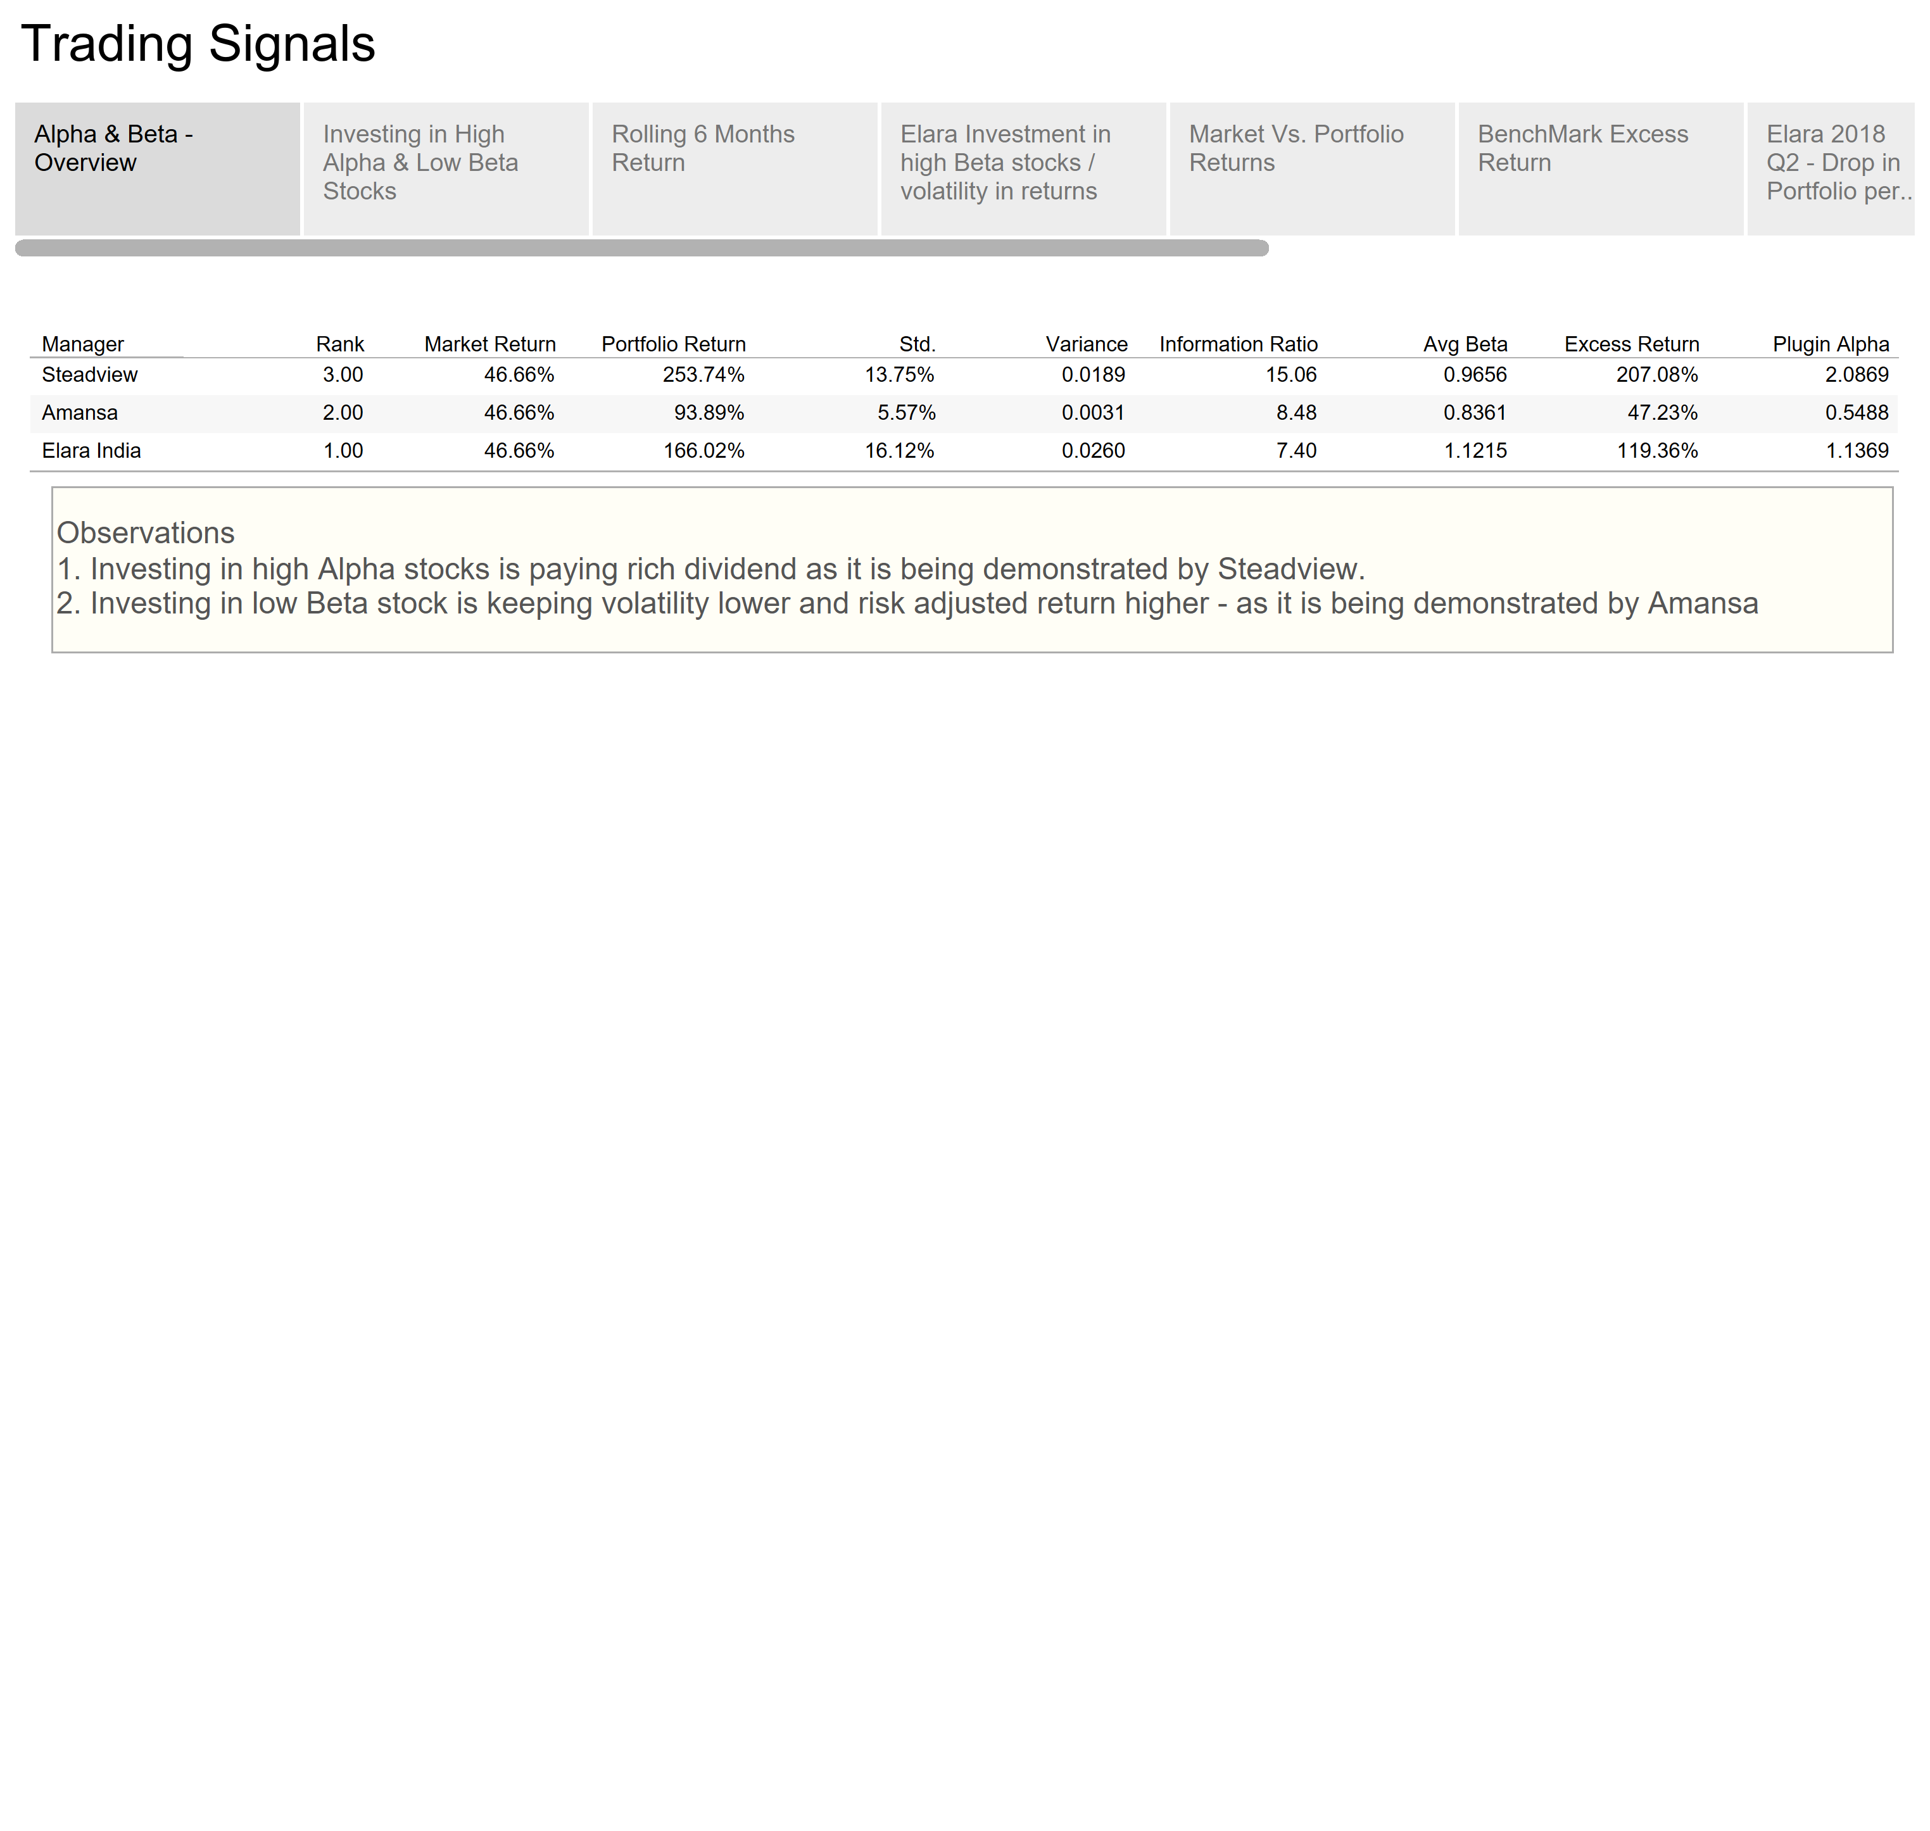

Slide 13
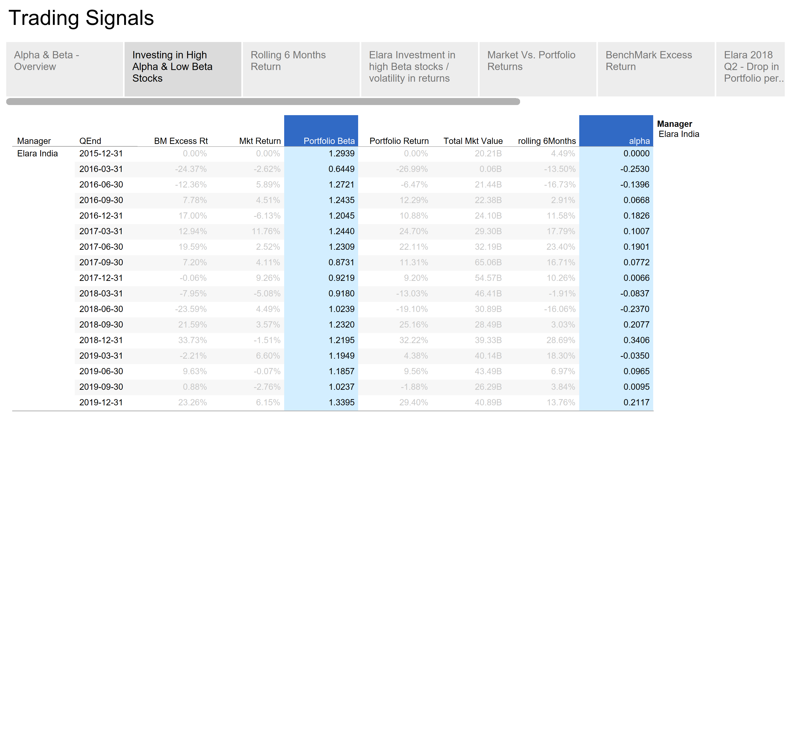

Slide 14
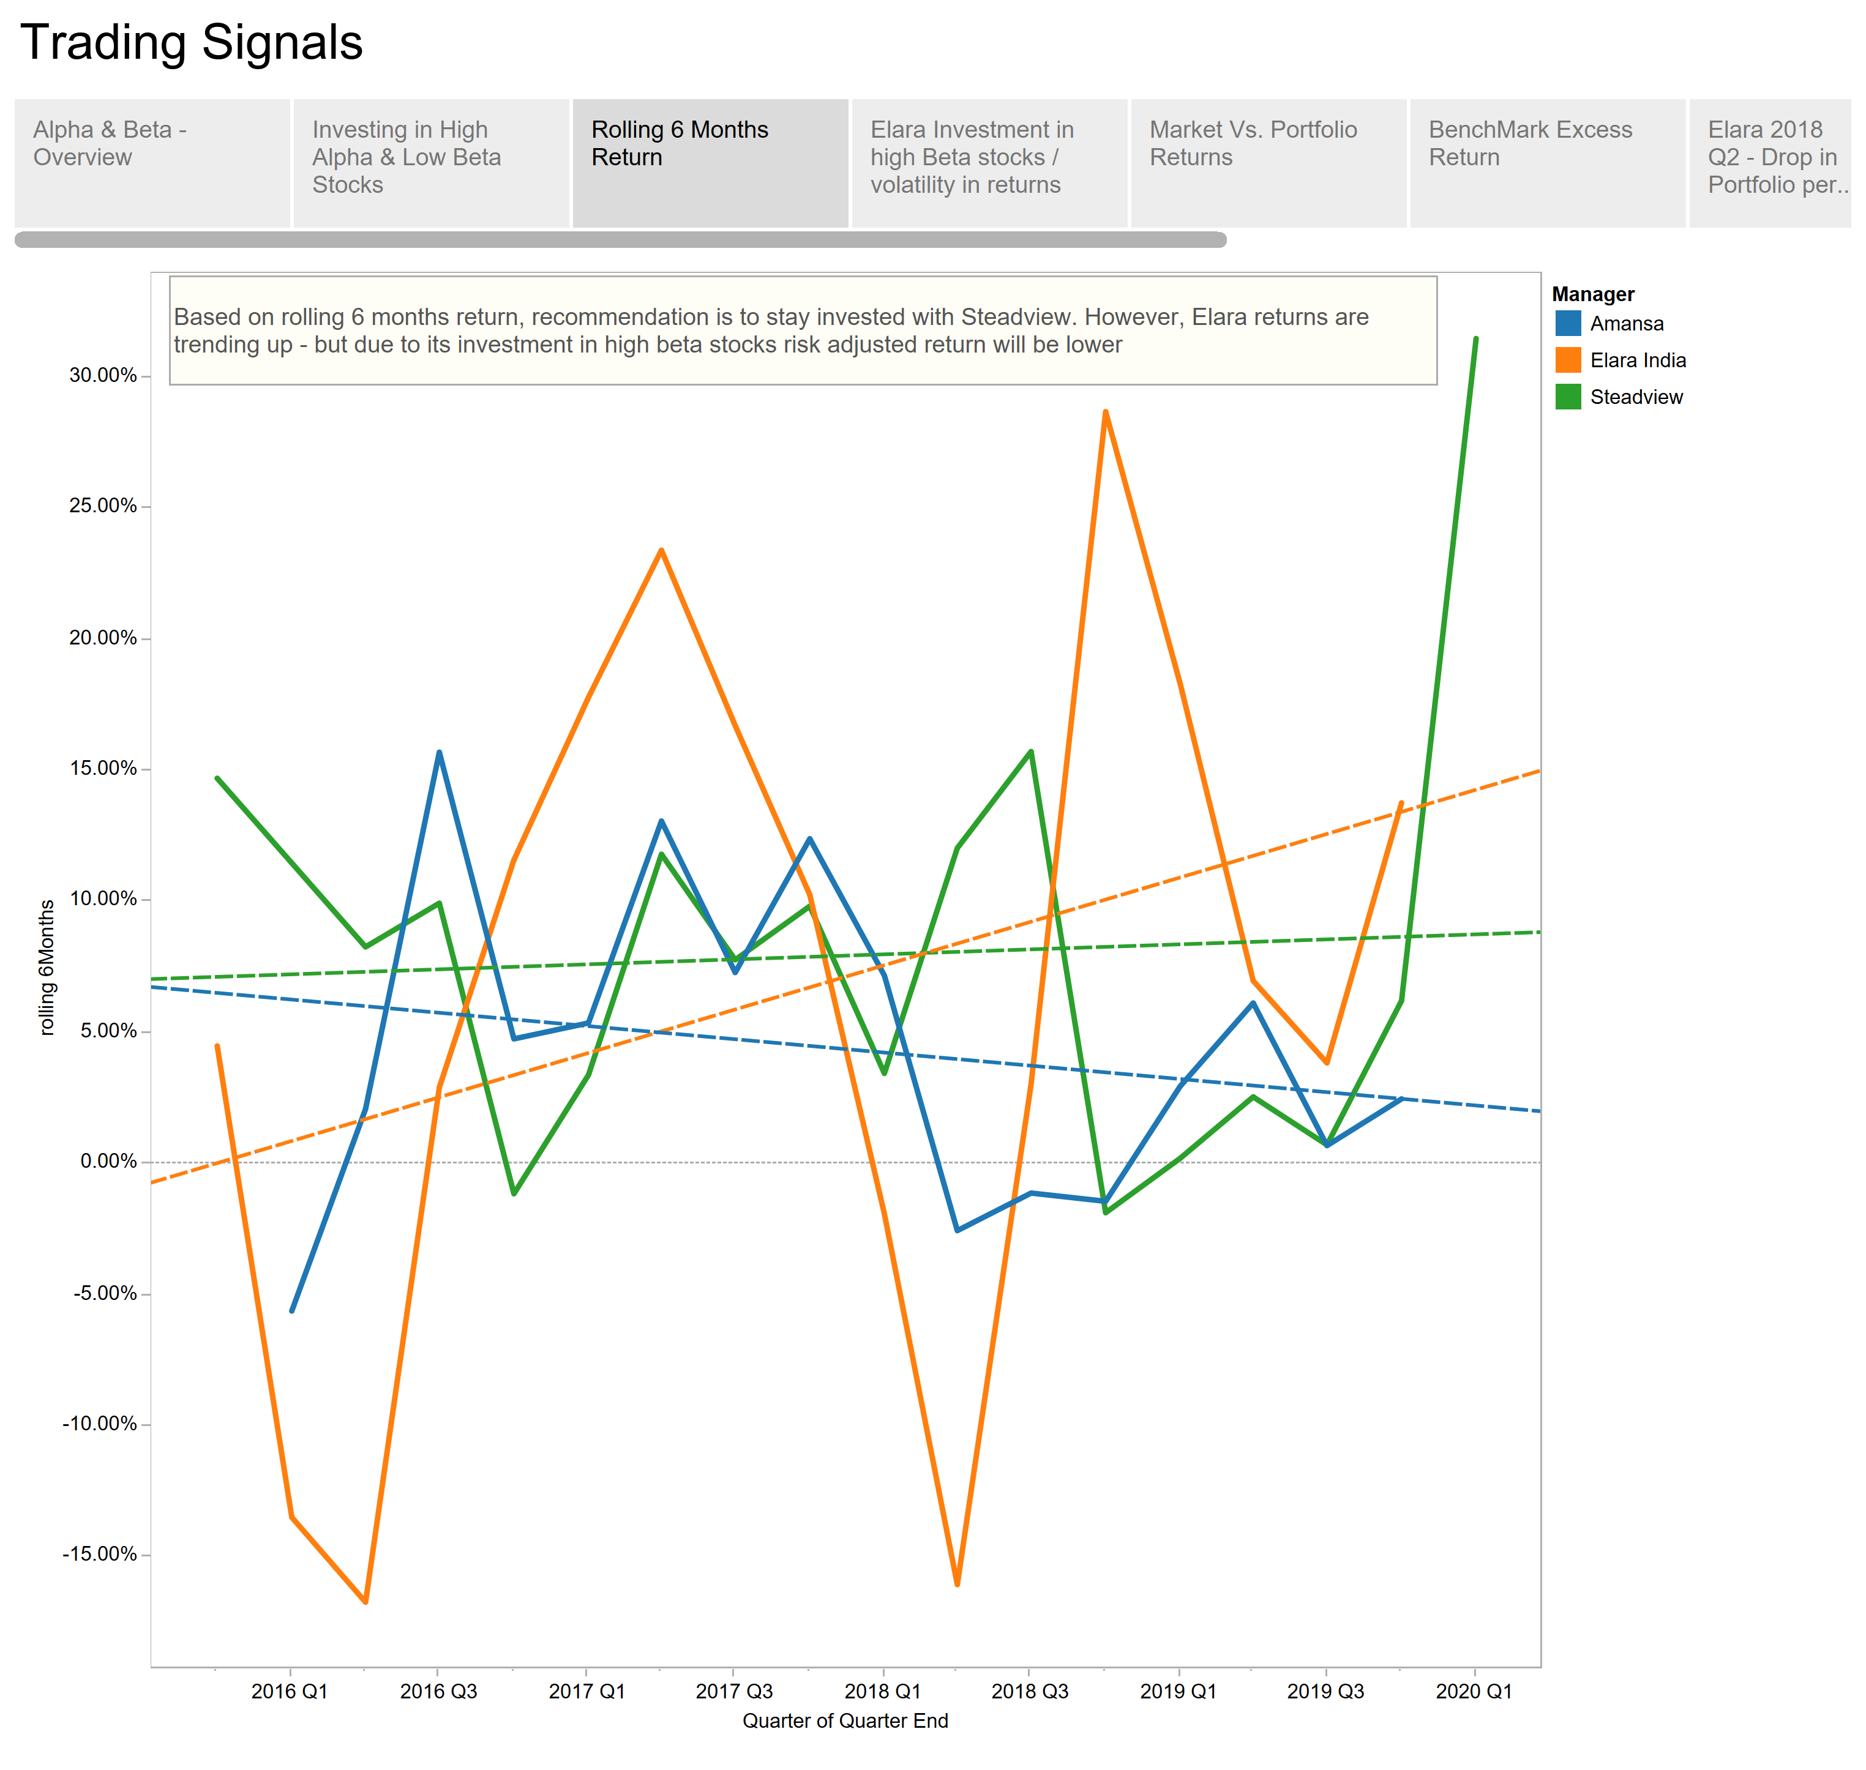

Slide 15
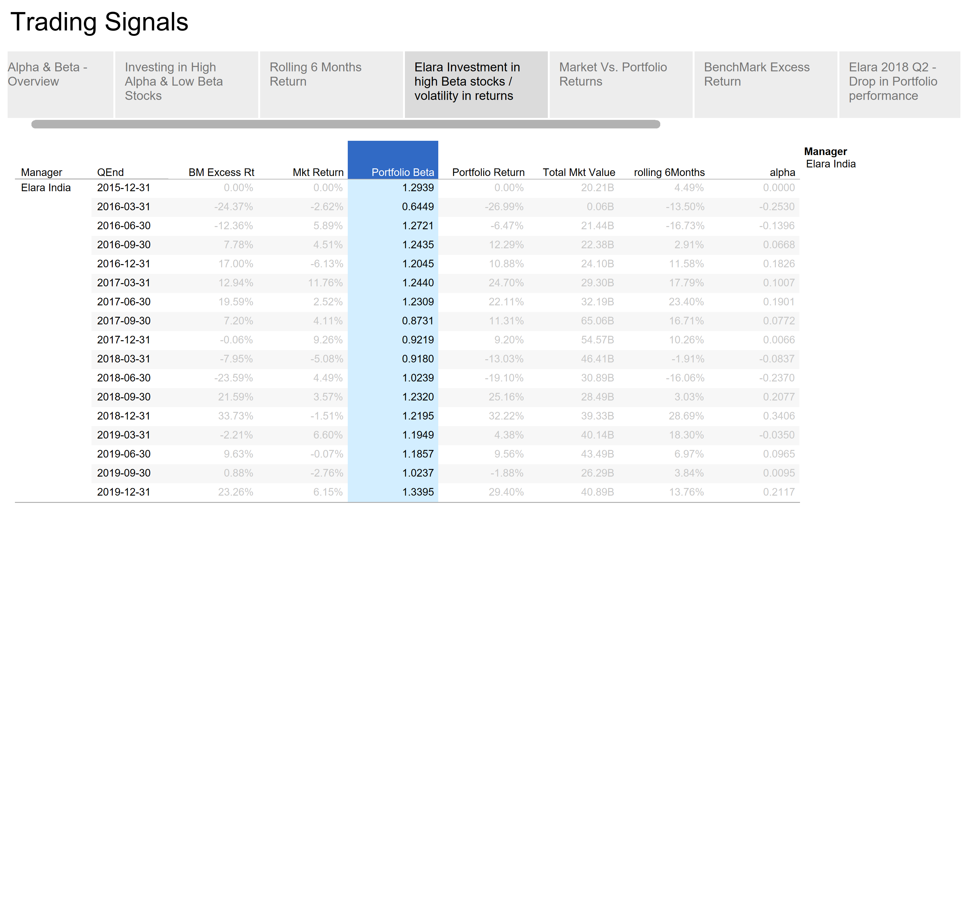

Slide 16
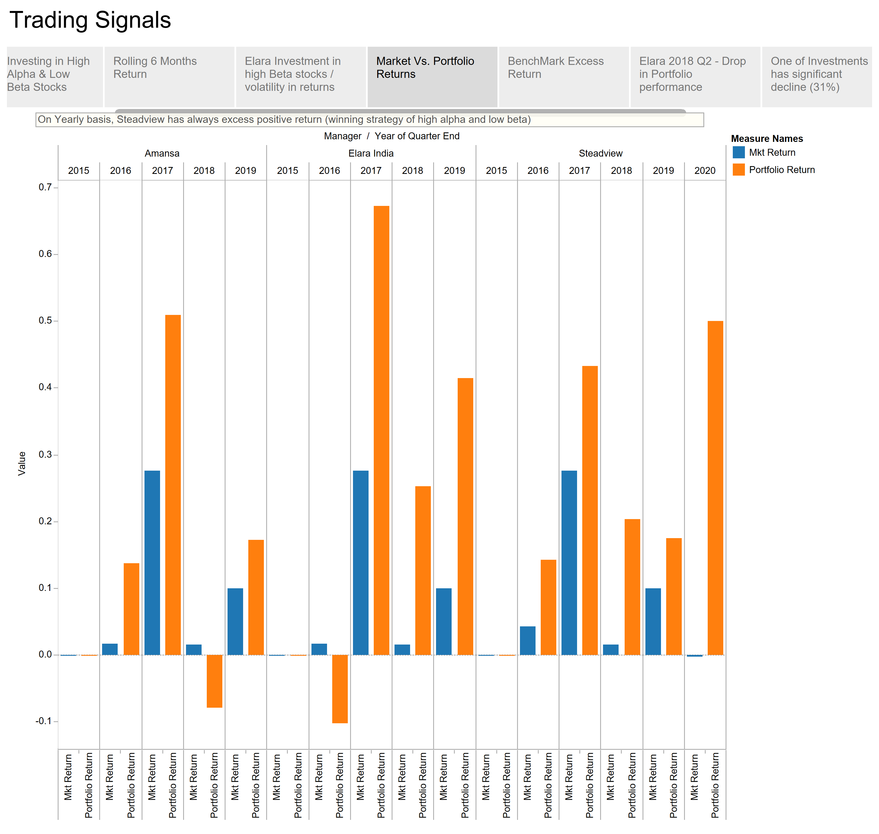

Slide 17
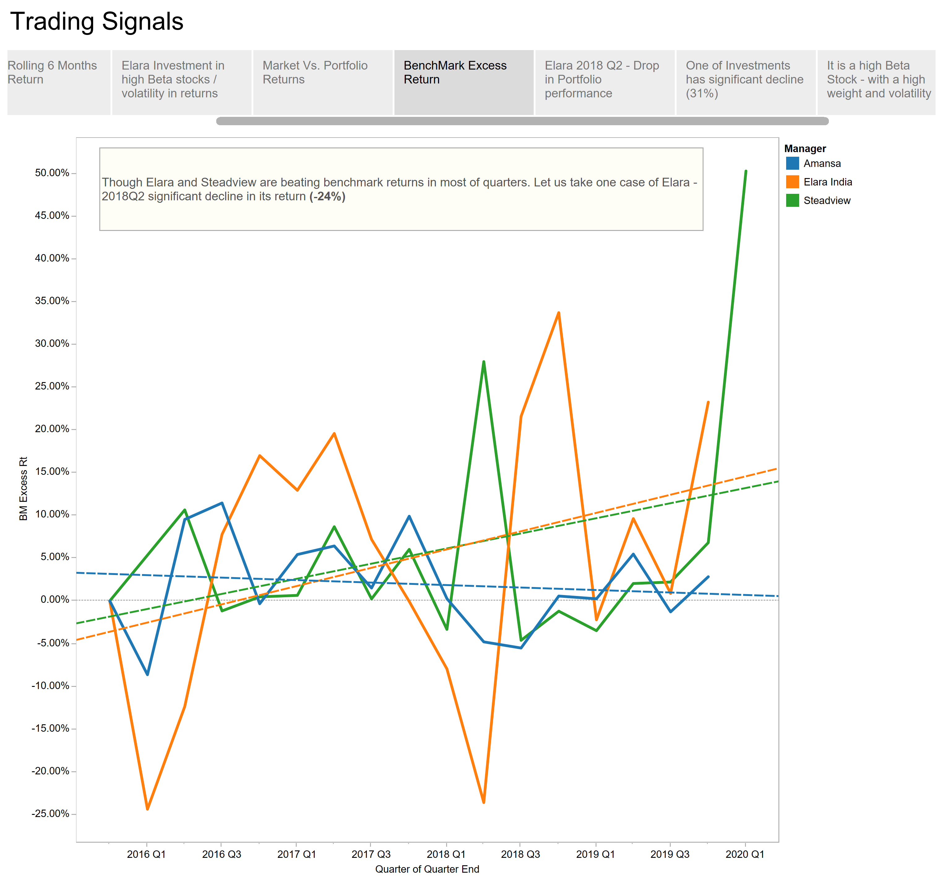

Slide 18
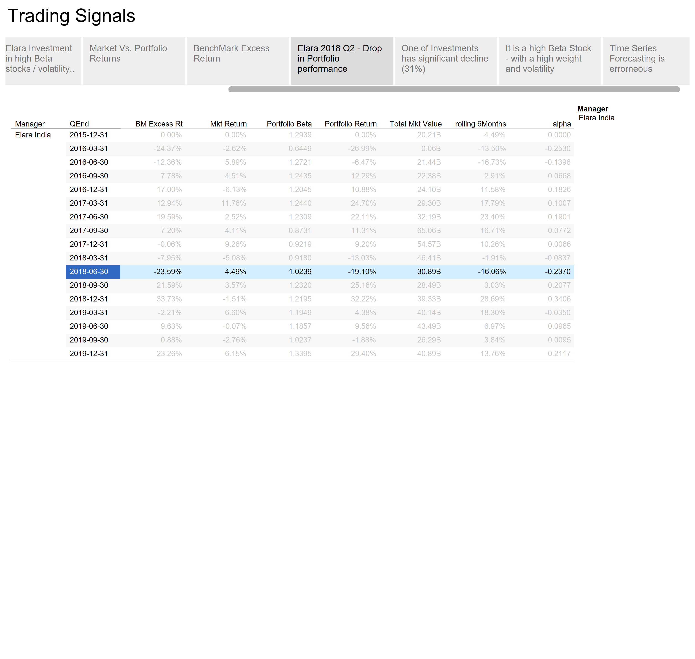

Slide 19
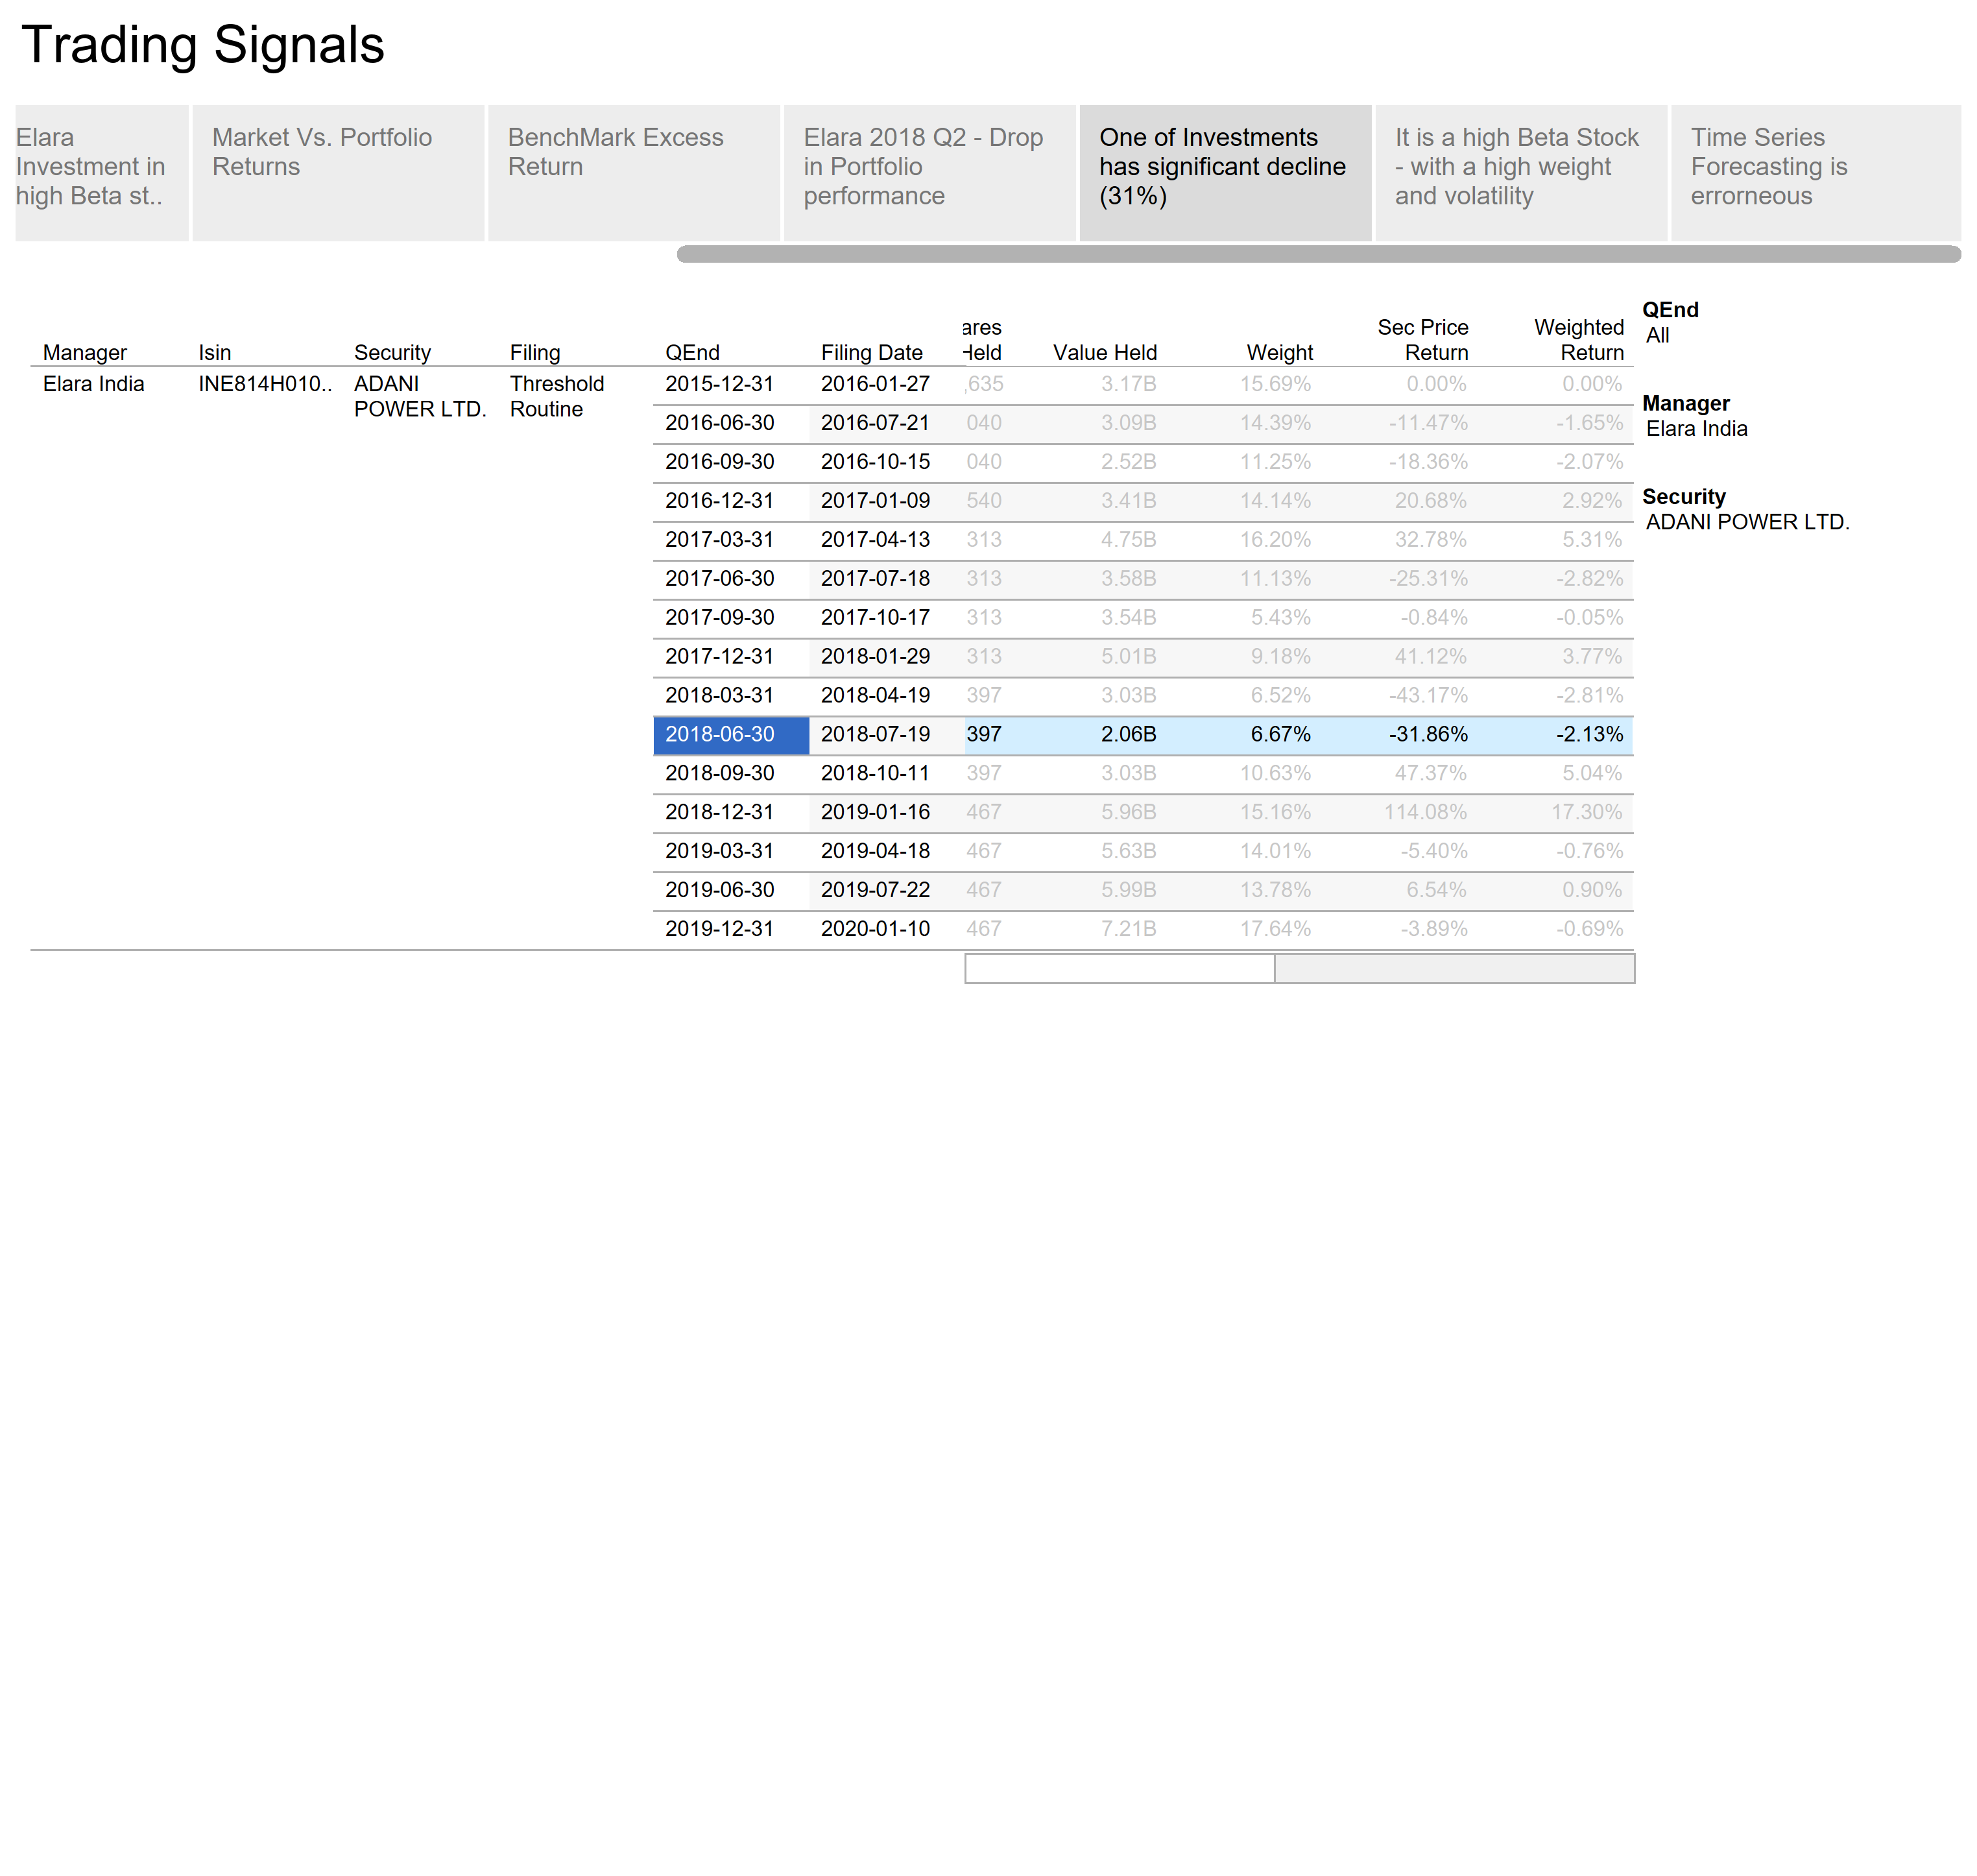

Slide 20
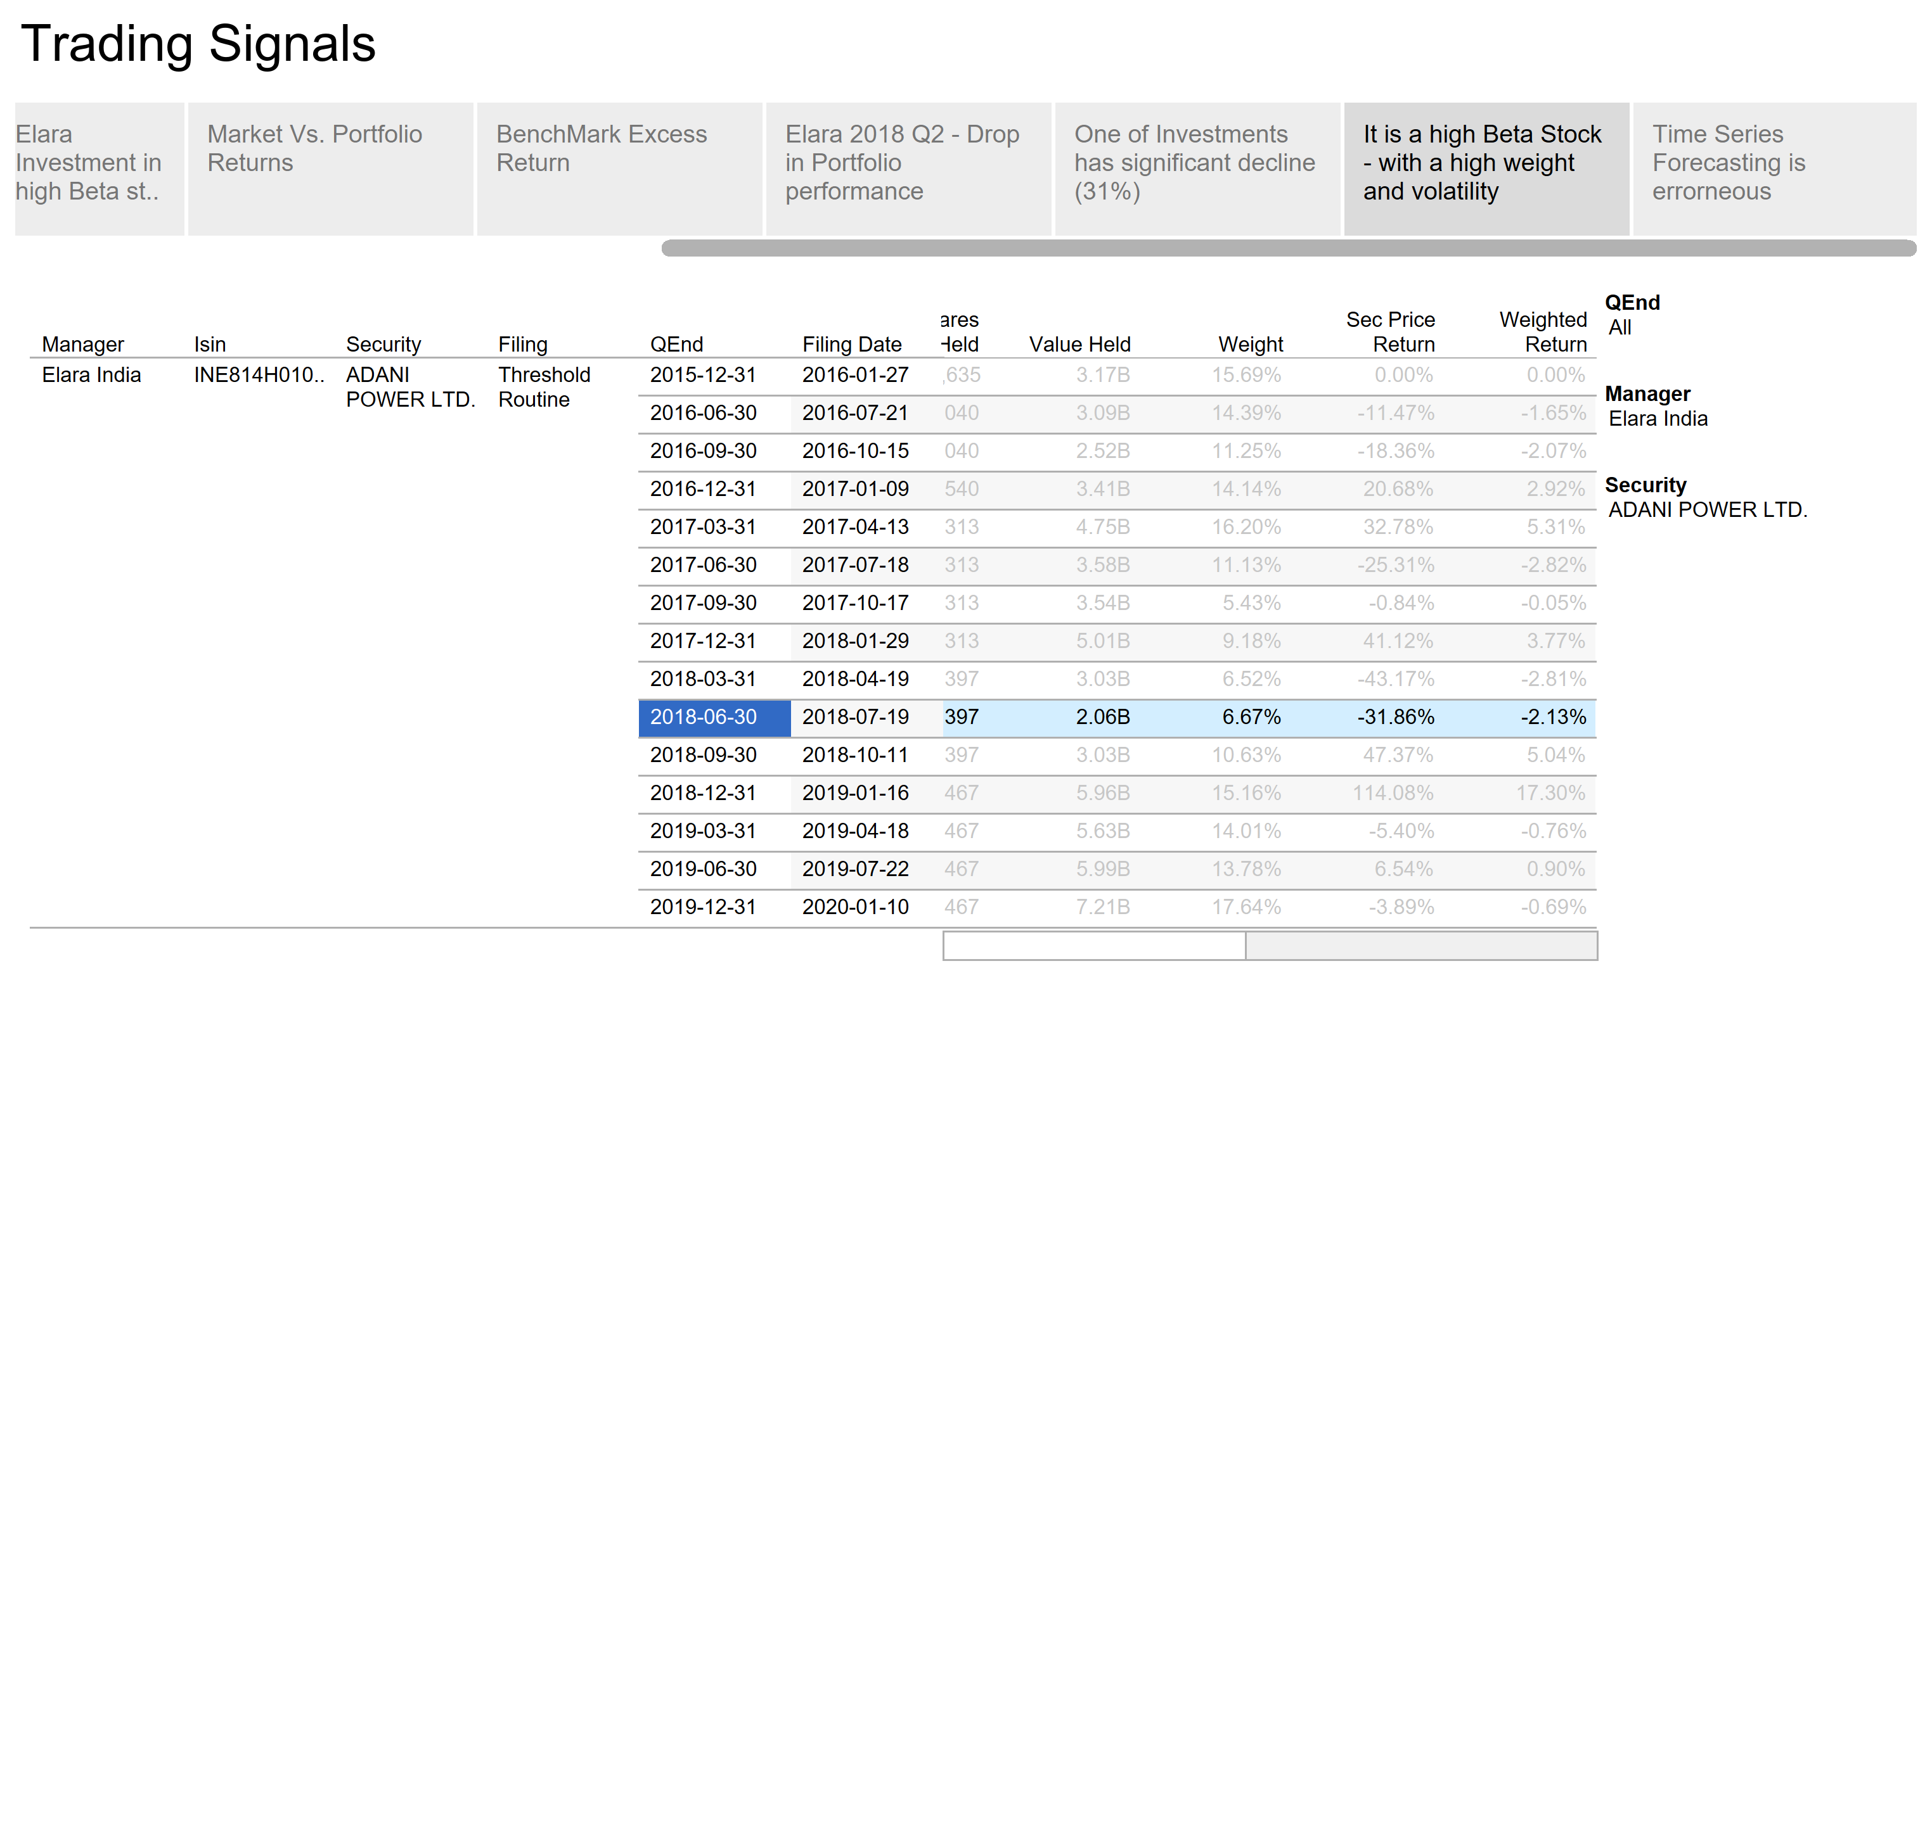

Slide 21
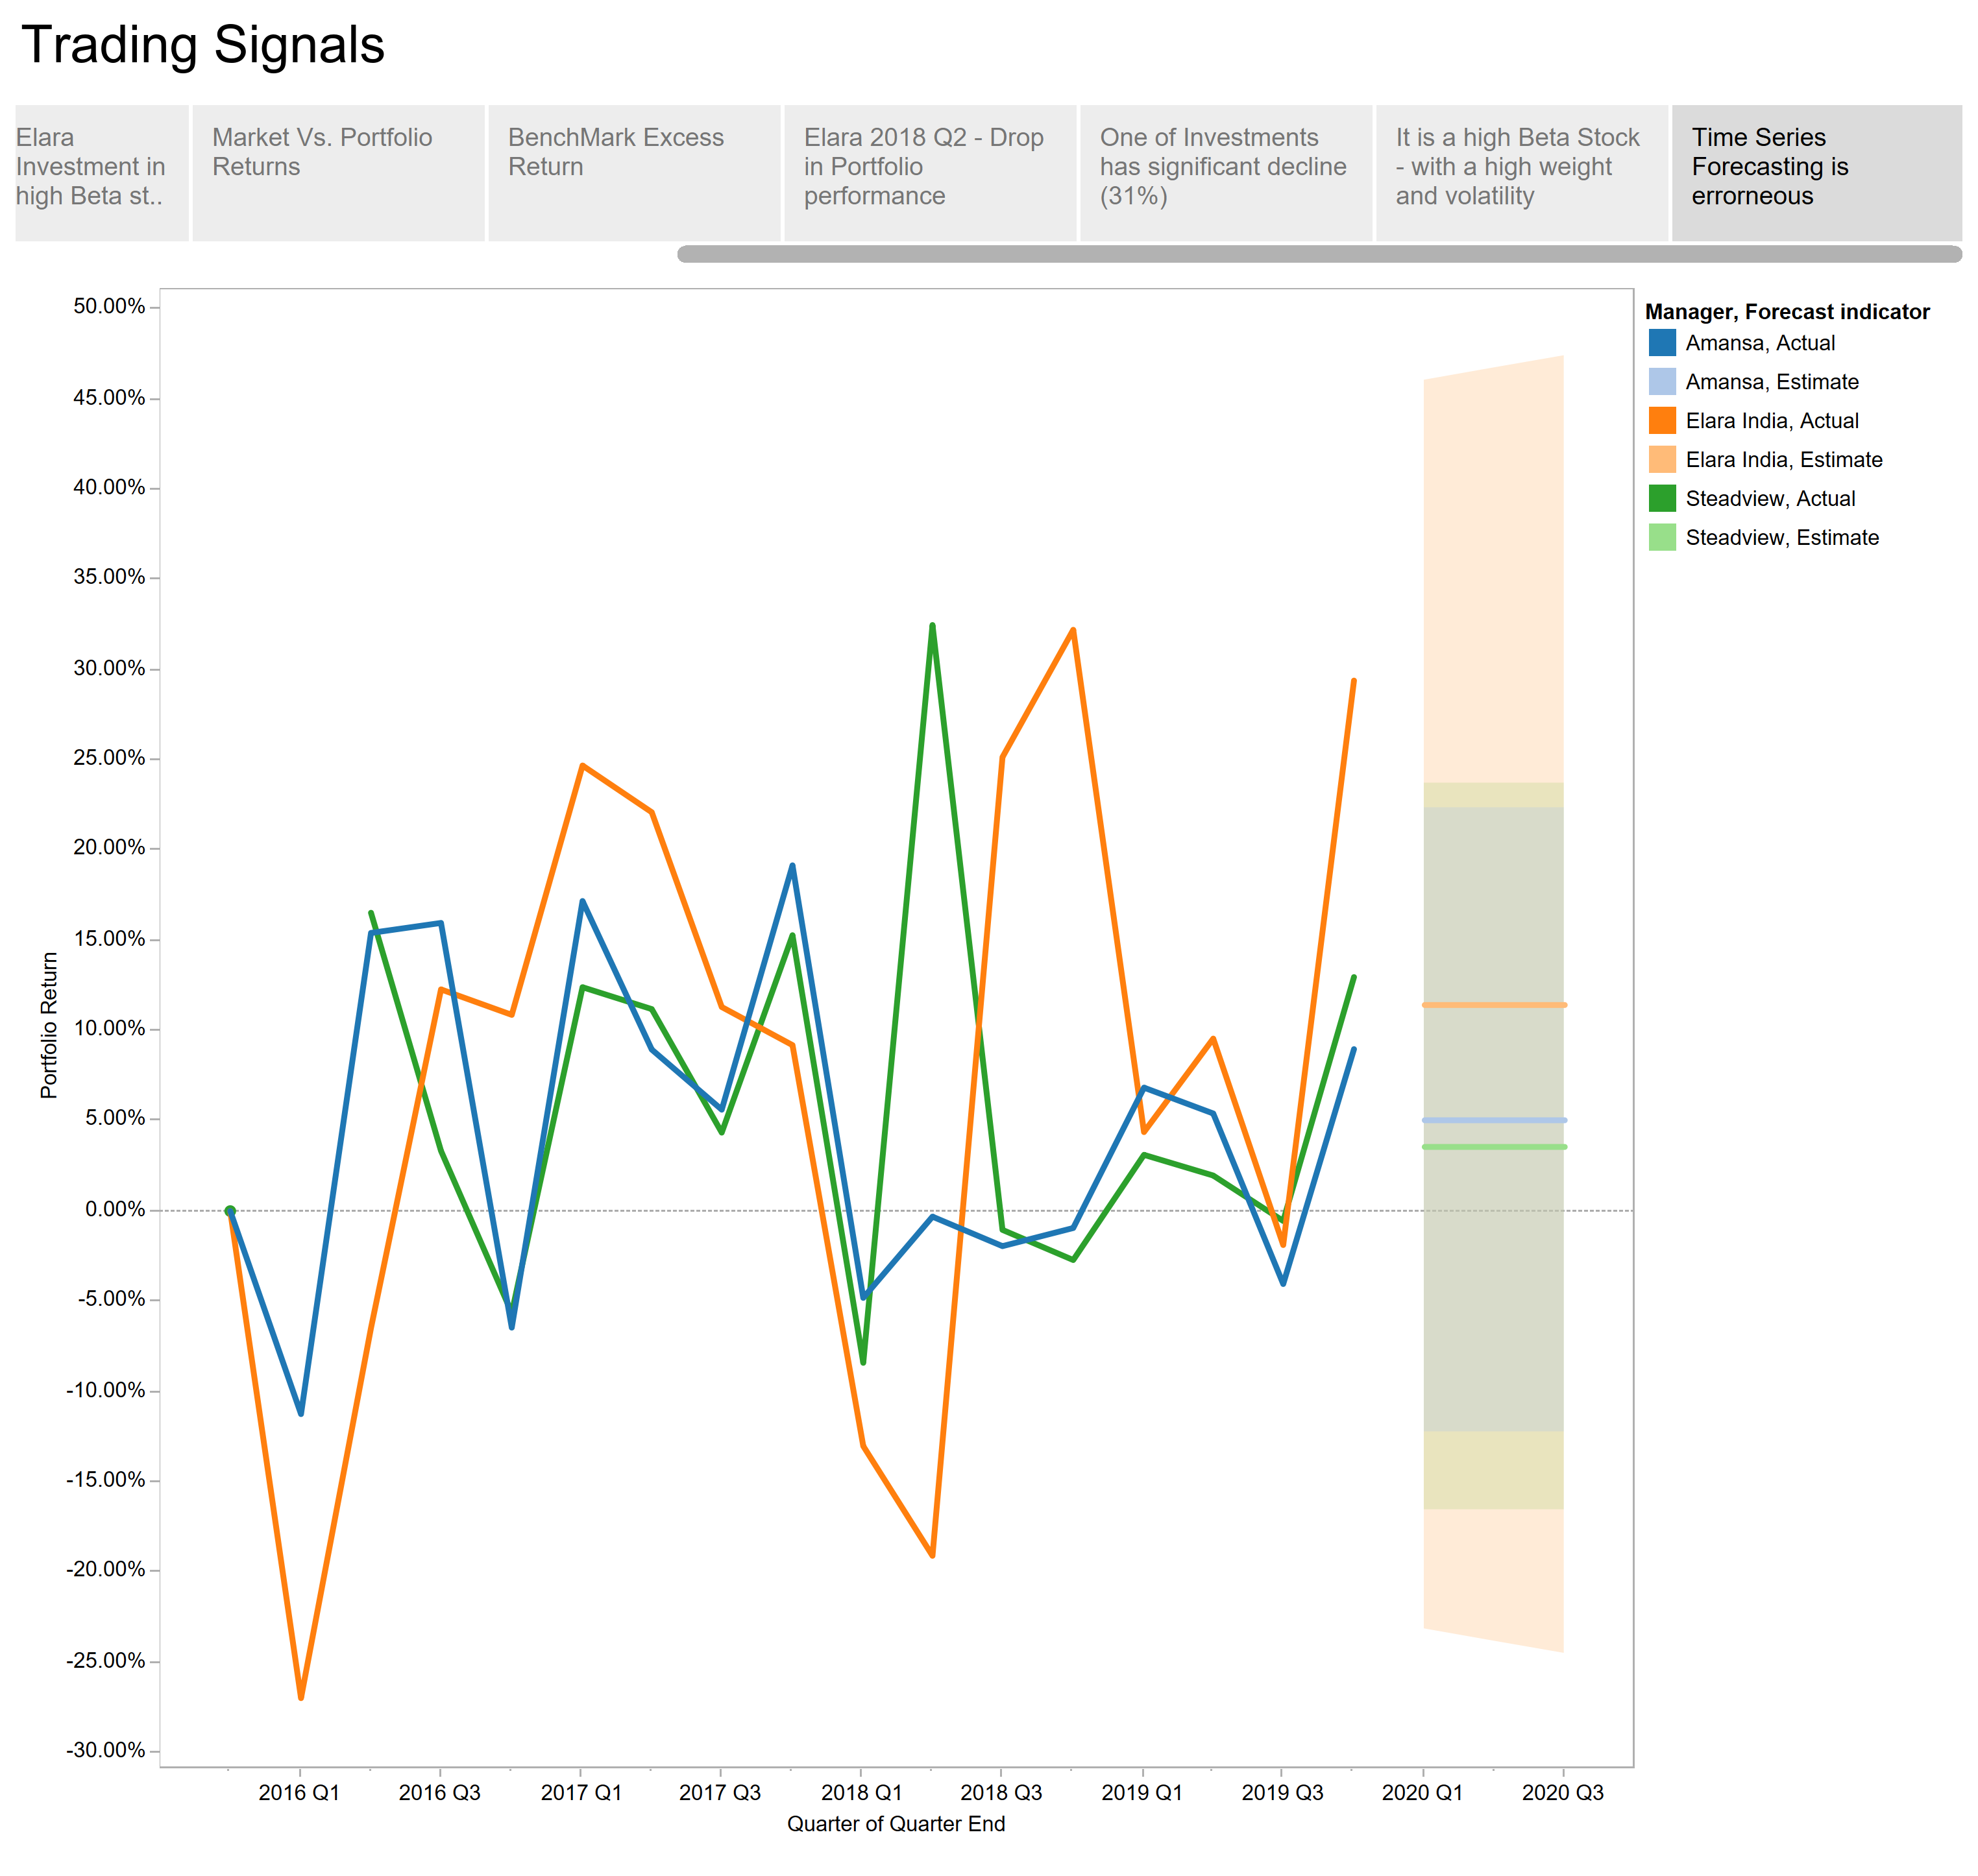

Slide 22
Part 3 – If I have more time and data
If I would have had one more day:
I would have asked for the Risk Free Rate
I would have produced Sharpe Ratio, Treynor Measure, M Square Measure, and Jenson’s ex post alpha to measure Portfolio’s risk based performance and ranking
If I would have had seven more days:
I would have asked for Covariance Matrix to calculate Portfolio Risk and risk adjusted returns
I would have asked for Cashflow data to calculate true time weighted returns correctly
I would have asked for stock Transaction data to calculate true positions on each quarter end. This would have made Portfolio returns more accurate
I would have used rolling beta (beta changes with time), and rolling beta would have improved Portfolio return calculations

Slide 23
Part 3 – If I have more time and data (cont..)
If I would have had one more month:
I would have asked for daily stock positions to calculate VAR and for predictive modelling (time series)
I would have asked for policy allocations to see how portfolio returns deviated from its goals
With Cashflow and Risk free data, I would have conducted Macro Portfolio performance attribution – to find how the mangers stock picking ability is contributing towards return
I would have drawn performance quality control charts – to find if returns are due to manager’s ability or by luck
Last but not the least, I would have done a predictive modeling based on Macro-Economics and fundamental factors

